Slide 1
Are Academic Journals Still Relevant for Researchers?
Carol Tenopir University of Tennessee
and
Hanken School of Economics ctenopir@utk.edu

Slide 2
Academic Year 2016-2017
A bit about me…

Slide 3
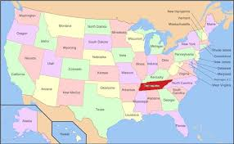
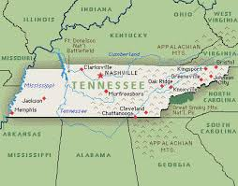
University of Tennessee, Knoxville

Slide 4
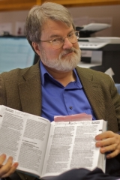
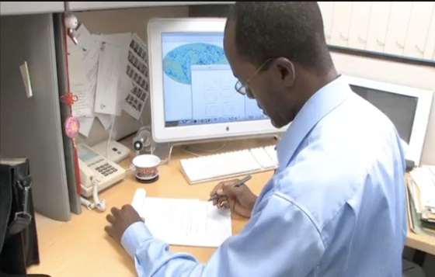
Overarching Research Question
How do researchers access, read, use, and value scholarly publications in their work?
Notes:
What is the value of reading to their work?
How should scholarly publications and systems change (or not) in the future to better meet their needs?

Slide 5
Finland Reading Study
Online survey sent to Finnish scholars
528 total respondents (although the number for any one question may vary)
Follow-up interviews
Replicates and expands on a 2007 survey in Finland
Notes:
Replicates studies 2011, 2012, 2013 in UK, US, Australia
Finland 2006; others from 1977-

Slide 6
In the information context economist Machlup described 2 types of value:
purchase or exchange value: what one is willing to pay for information in money and/or time, and
use value: the favorable consequences derived from reading and using the information.

Slide 7
4 types of questions
Therefore, insights into
both READERS and READINGS
Demographic
Recollection
Critical Incident
Comments

Slide 8
Critical incident of last reading
“The following questions in this section refer to the SCHOLARLY ARTICLE YOU READ MOST RECENTLY, even if you had read the article previously. Note that this last reading may not be typical, but will help us establish the range of patterns in reading.”
Notes:
5/22/2017
8

Slide 9
A few preliminary findings…
Scholarly article reading is important for academic work
Many, but not all, readings come from the library
Not every reader is the same
Some things have changed
Some things may change in the future
Notes:
Today I have selected 4 preliminary findings:
1.Scholarly articles are important for academic work
2.Many, but not all, readings come from the library (whether readers know it or not OR the library has competition)
3. Not every reader is the same
4. What has changed?
5. What may change in the future?

Slide 10
Scholarly article reading is important for academic work
Notes:
5/22/2017
10

Slide 11
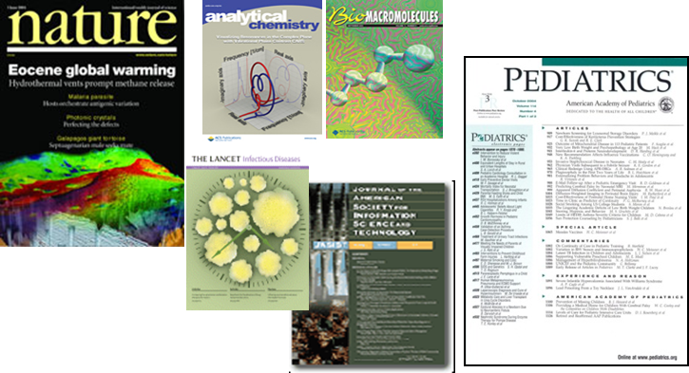
Researchers read a lot …article readings per month
20 readings per month on average by Finnish researchers
X
12 months per year =
240 article readings/year
2016, Finland N=456
Notes:
In US in 2012 = 21; UK 2011=22; Australia in 2013 = 25
Number of other publications read per month (all together): M=68.85
Breakdown (Mean):
News articles: 48.56
Magazine or trade journals: 8.64
Blogs: 4.33
Scholarly books/book chapters: 2.86
Government documents, technical or research reports: 2.47
Conference proceeding articles: 2.42
Fiction: 1.10
Other: 1.08
Non-fiction: 0.81
What type of other publication most recently read:
Book / book chapters: 21.8%
News: 16.2%
Magazines: 13.5%
Govt doc: 12.5%
Conference proceedings: 9.0%
Fiction: 7.2%
Other: 7.0%
Other Nonfiction: 6.5%
Blogs: 6.3%

Slide 12
And they spend time reading
42 minutes per article reading
x 20 readings per month = 14 hours/month
X 12 months/year = 168 hours/year
OR 21 8-hour work days
2016, Finland N=444
Notes:
37 minutes with outliers removed

Slide 13
Outcomes of article readings
#1 Inspire new thinking or ideas (54%)
#2 Helped justify my work (47%)
#3 Improved the results (21%)
#4 Narrowed/broadened/changed focus (17%)
#5 Saved time or other resources (10%)
….
#10 Wasted my time (1%)
Notes:
Finland 2016:
• Inspire new thinking (53.6%, 283 of readings)
• Helped me justify my work or make critical comments (40%/211of readings)
• Improved the result (21.4%, 113 of readings)
• Narrow, broaden, or change the focus (16.7%/88 of readings)
• Saved time (10% 53 of readings)
• Resolved technical problems (7.4%/39of readings)
• Lead to faster completion of the task at hand (6.8% /36 of readings)
• Made me question my work (3.6%/19 of readings)
• Resulted in collaboration / joint research(3%/16 of readings)
• Wasted my time (1.1%/6 of readings)

Slide 14
They read articles for many different purposes…
n=454, 2016, Finland
Notes:
Research, writing reports, articles, & writing grants, funding opportunities were combined. Current awareness and continuing education also combined.

Slide 15
Readings for research are...
Read longer
Ranked more highly valuable to purpose
Most often come from the library

Slide 16
2. Many readings come from the library (but not all)

Slide 17
Source of article readings (for all purposes)
Notes:
Looks pretty similiar

Slide 18
Library provided articles are…
…most often for research or writing
…more important to principal purpose
…more likely to be read in e-format
…more likely to be cited (already or in the future)
Notes:
58% are read in e format

Slide 19
Just because they read articles from the library (all article readings)…
n=453, Finland, 2016
Notes:
Do this also with all article readings and see how it differs
LC note: doesn’t differ all that much.

Slide 20
3. Not every reader is the same

Slide 21
Article Readings differ by discipline (average per month)
Readings per month
n=439, Finland, 2016
Notes:
Sciences: 23/month
Medical sciences: 22
Engineering: 22
Social sciences: 17
Humanities: 8
Compared to US 2012 numbers are lower. In humanities 8 vs. 21!
In business (n=35) 26 article readings/month (highest value)

Slide 22
Book or chapter readings differ by discipline (average per month)
n=450, Finland, 2016
Notes:
Books and chapters
In business (n=35) 2,6

Slide 23
Does age of reader matter?
There is no age difference in use of social media based on age
Notes:
30 and under:
Read more often at the office
Spend more time per article reading
More often get readings from colleagues
61+:
Read more books/book chapters
Read more from print
Read more in Swedish or Finnish

Slide 24
Portrait of a ‘successful’ academic who has…
…won an award in the last two years.
…published about 9 works in the last two years.

Slide 25
Reading characteristics of a ‘successful’ academic:
Reads a greater variety of materials.
Spends more time per reading.
Uses the library for articles, but not as much for other types of publications.
Considers listservs, cloud services, research social networks, and collaborative authoring platforms to be important to work.

Slide 26
4. Some things have changed

Slide 27
Estimated e-article reading
2007 15 electronic articles/month average
180 e-articles per year
2017 17 electronic articles/month average
204 e-articles per year (83% of total readings)
Notes:
In 2007 we asked: How many scholarly articles that you have obtained in electronic form have you read during the last month?
Average14,8 articles per month (x12= 180 per year)
In 2016 we asked: In the past month, approximately how many scholarly articles have you read?
Average19,68 articles per month (x12 = 236,16 per year)
86 % of latest article readings were obtained from electronic source:
Estimated average 16,9 e-articles per month (x12 = 204 per year)
2007: 10 median, 22,865 std, N=947
2016 Average 19,68 articles 10 median, 28,34 std N=454
86 % of latest article readings were obtained from electronic source:
Estimated average 17

Slide 28
Where were you when reading the last e-article?
Notes:
Where were you when reading the last e-article?
2006 N= 1663
2016 N= 430
People read less at office and library and more at home and elsewhere (e.g. travelling)

Slide 29
How did you become aware of the last e-article you read?
Notes:
How did you become aware of the last e-article you read?
2006 N=913
2016 N=430 (print articles removed from the analyses)
2016:
less browsing
less searching
more from citations and from other persons => more sharing?
Out of ”other” 52 % email alerts/research social networks/social media
2006:
Out of ”other”: RSS feed 70 %

Slide 30
Newer technologies & platforms are increasingly important to work…
Collaborative authoring tools (58%)
Research social networks (55%)
Institutional repositories (51%)
Notes:
Considered ”important”, ”very important”, or ”absolutely essential” to their work
Social scientists more than other disciplines, followed closely by life scientists

Slide 31
Finding articles has changed:
“I find many more papers as a result of being on Twitter.”
“I read more working papers and early versions that are freely available on the web.”
“The search services available in the Web are completely sufficient for finding materials so there is no need for special search services provided by the library.“
Notes:
“I get a lot of hints about good articles from social media.”

Slide 32
Reading has changed for most:
“I’ve mainly moved onto electronic publications, because they are easy to save and share.”
“I read more because I can read on the phone and other smart devices.”
“Because of haste and time pressures, it’s necessary to only browse through articles and pick up the necessary things. There’s no time to read the full article in peace.”
Notes:
Many said hasn’t changed much

Slide 33
5. Some things need to change (and some shouldn’t)

Slide 34
The content is more important to me than…fancy features
Ability to make my own notes easily
Open peer review with public comment functionality
Desired Future?
Links to cited works and links to research data
Open access for all
E-reader (i.e., Kindle) compatability
Notes:
I would love for [readings] to be published in e-reader form, i.e. Kindle-compatible. I hate reading demanding texts from backlit tablets (however, entertainment texts are fine.)
I still prefer reading from paper and not from a screen. If changes come, such as easier cross-reference links from pdfs or videos in documents, I might read more papers, or might read more from screen.

Slide 35
Any changes must…
…Fit with work patterns
…Be easier than current ways
...Recognize need for quality
…Fit a range of behaviors and devices
Notes:
What is the value of reading to their work?
How should scholarly publications and systems change (or not) in the future to better meet their needs?

Slide 36
Thank you!
Carol Tenopir ctenopir@utk.edu

